Slide 1

Microsoft Power BI
Super Store Sales Analysis
(Using POWER BI)

Slide 2
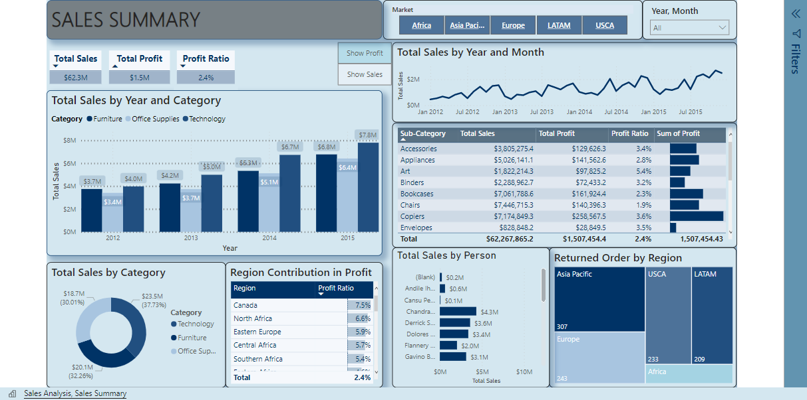
Microsoft Power BI

Slide 3
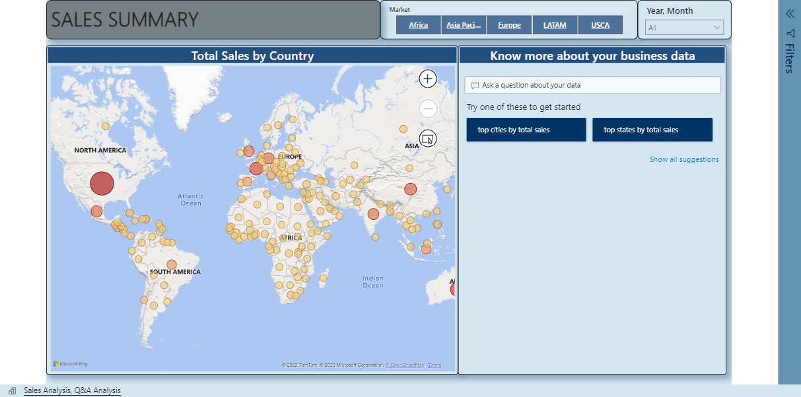
Microsoft Power BI

